Slide 1

Intro to spatial data in R (sf)
dr Maria Kubara

Slide 2
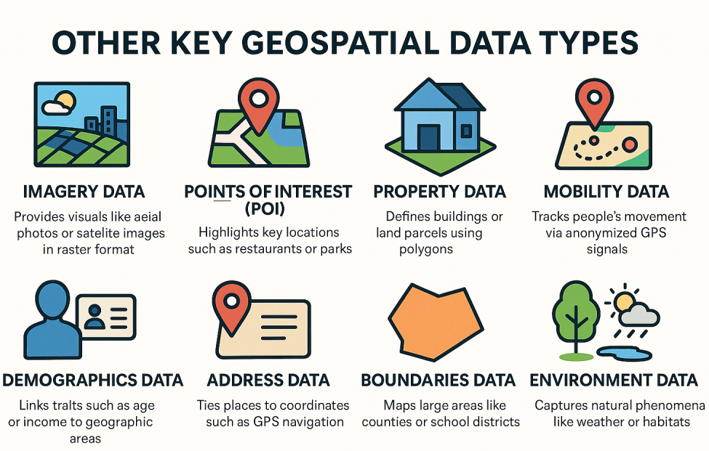
What is geospatial data?
Geospatial data = data with location
Each observation has:
  attributes (what?)
  geometry (where?)
Location can be represented as:
  points (events, firms, people)
  lines (roads, rivers, flows)
  polygons (regions, districts, markets)
👉 Same logic as a table (features, attributes) — but with space attached.

Slide 3
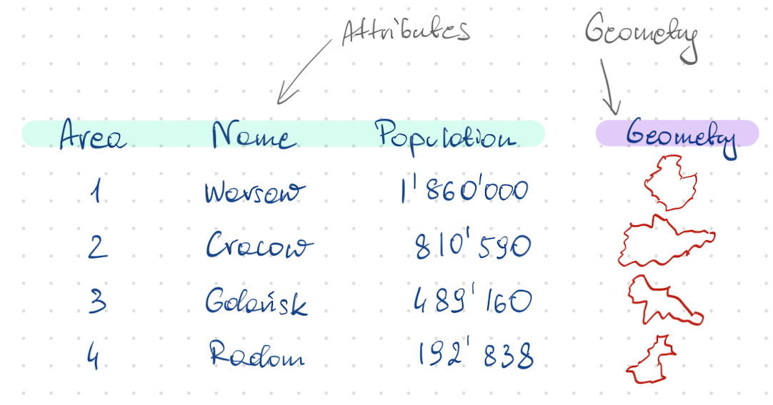
Geometry vs attributes
Two inseparable components of spatial data
Attributes
  variables you analyse (prices, counts, rates)
Geometry
  coordinates defining
  location or extent
  how objects relate in space
Spatial analysis = working with both at the same time

Slide 4
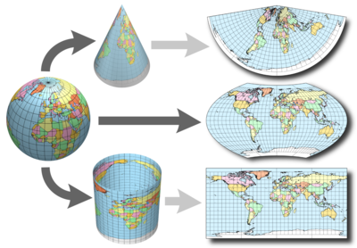
Coordinate Reference Systems (CRS)
What is a CRS?
A CRS defines how coordinates map to the Earth
It answers:
  What do these numbers mean?
  Are they degrees or meters?
Two common cases:
Geographic CRS
  longitude / latitude (degrees)
Projected CRS
  flat map (meters, kilometers)
⚠️ Distances, buffers, and areas only make sense with the right CRS.
Nice resource: https://earthdatascience.org/courses/use-data-open-source-python/intro-vector-data-python/spatial-data-vector-shapefiles/geographic-vs-projected-coordinate-reference-systems-python/

Slide 5
How to store spatial data in R (historically)
ESRI shapefiles – an old, golden standard for spatial data storage
GDAL and GEOS software to read and manipulate the data
Early R solution
  sp package (2003)
  S4 classes with slots
  many dependencies
  powerful, but heavy
Key limitations
  complex structure (not data.frame)
  difficult integration with tidyverse
  issues with geometry handling (e.g. polygon holes)
  accuracy problems after transformations

Slide 6
S4 class for data storage
> library(sp)
> getClass("Spatial")
Class "Spatial" [package "sp"]
Slots:
Name: bbox proj4string
Class: matrix CRS
Known Subclasses:
Class "SpatialPoints", directly
Class "SpatialMultiPoints", directly
Class "SpatialGrid", directly
Class "SpatialLines", directly
Class "SpatialPolygons", directly
Class "SpatialPointsDataFrame", by class "SpatialPoints", distance 2
Class "SpatialPixels", by class "SpatialPoints", distance 2
Class "SpatialMultiPointsDataFrame", by class "SpatialMultiPoints", distance 2
Class "SpatialGridDataFrame", by class "SpatialGrid", distance 2
Class "SpatialLinesDataFrame", by class "SpatialLines", distance 2
Class "SpatialPixelsDataFrame", by class "SpatialPoints", distance 3
Class "SpatialPolygonsDataFrame", by class "SpatialPolygons", distance 2
> slotNames("SpatialPoints")
[1] "coords" "bbox" "proj4string"
> slotNames("SpatialPointsDataFrame")
[1] "data" "coords.nrs" "coords" "bbox" "proj4string"
> voi<-readOGR("data", "wojewodztwa") # 16 jedn.
> voi<-spTransform(voi, CRS("+proj=longlat +datum=NAD83"))
> class(voi)
[1] "SpatialPolygonsDataFrame"
attr(,"package")
[1] "sp"
> str(voi)

Slide 7
Formal class 'SpatialPolygonsDataFrame' [package "sp"] with 5 slots
..@ data :'data.frame': 16 obs. of 29 variables:
.. ..$ iip_przest: chr [1:16] "PL.PZGIK.200" "PL.PZGIK.200"...
.. ..$ jpt_sjr_ko: chr [1:16] "WOJ" "WOJ" "WOJ" "WOJ" ...
.. ..$ jpt_kod_je: chr [1:16] "16" "26" "04" "14" ...
.. ..$ jpt_nazwa_: chr [1:16] "opolskie" "świętokrzyskie" ...
[…]
..@ polygons :List of 16
.. ..$ :Formal class 'Polygons' [package "sp"] with 5 slots
.. .. .. ..@ Polygons :List of 1
.. .. .. .. ..$ :Formal class 'Polygon' [package "sp"] with 5 slots
.. .. .. .. .. .. ..@ labpt : num [1:2] 17.9 50.6
.. .. .. .. .. .. ..@ area : num 1.2
.. .. .. .. .. .. ..@ hole : logi FALSE
.. .. .. .. .. .. ..@ ringDir: int 1
.. .. .. .. .. .. ..@ coords : num [1:23869, 1:2] 16.9 16.9 16.9 ...
.. .. .. ..@ plotOrder: int 1
.. .. .. ..@ labpt : num [1:2] 17.9 50.6
.. .. .. ..@ ID : chr "0"
.. .. .. ..@ area : num 1.2
.. ..$ :Formal class 'Polygons' [package "sp"] with 5 slots
.. .. .. ..@ Polygons :List of 4
.. .. .. .. ..$ :Formal class 'Polygon' [package "sp"] with 5 slots
.. .. .. .. .. .. ..@ labpt : num [1:2] 20.8 50.8
.. .. .. .. .. .. ..@ area : num 1.49
.. .. .. .. .. .. ..@ hole : logi FALSE
.. .. .. .. .. .. ..@ ringDir: int 1
.. .. .. .. .. .. ..@ coords : num [1:24862, 1:2] 19.7 19.7 19.7...
[…]
.. .. .. ..@ plotOrder: int [1:4] 1 2 3 4
.. .. .. ..@ labpt : num [1:2] 20.8 50.8
.. .. .. ..@ ID : chr "1"
.. .. .. ..@ area : num 1.49
.. ..$ :Formal class 'Polygons' [package "sp"] with 5 slots
.. .. .. ..@ Polygons :List of 1
.. .. .. .. ..$ :Formal class 'Polygon' [package "sp"] with 5 slots
.. .. .. .. .. .. ..@ labpt : num [1:2] 18.5 53.1
.. .. .. .. .. .. ..@ area : num 2.41
.. .. .. .. .. .. ..@ hole : logi FALSE
.. .. .. .. .. .. ..@ ringDir: int 1
.. .. .. .. .. .. ..@ coords : num [1:23150, 1:2] 17.2 17.2 17.2...
.. .. .. ..@ plotOrder: int 1
.. .. .. ..@ labpt : num [1:2] 18.5 53.1
.. .. .. ..@ ID : chr "2"
.. .. .. ..@ area : num 2.41
..@ proj4string:Formal class 'CRS' [package "sp"] with 1 slot
.. .. ..@ projargs: chr "+proj=longlat +datum=NAD83 +no_defs"

Slide 8
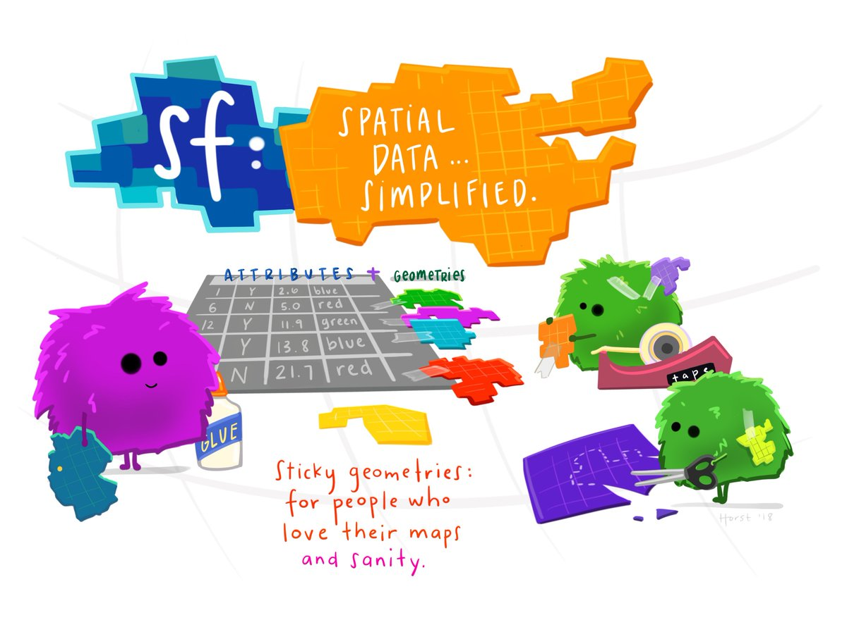
Source: https://r-spatial.github.io/sf/

Slide 9
Simple features
New standard for spatial data representation
  Herring, J. (2011). Opengis® implementation standard for geographic information-simple feature access-part 1: Common architecture [corrigendum].
Introduced to R via sf package
  Pebesma, E. J. (2018). Simple features for R: Standardized support for spatial vector data. R J., 10(1), 439.
A way to store spatial data in unified data frames
Utilising list-columns from tibbles to store geometries

Slide 10
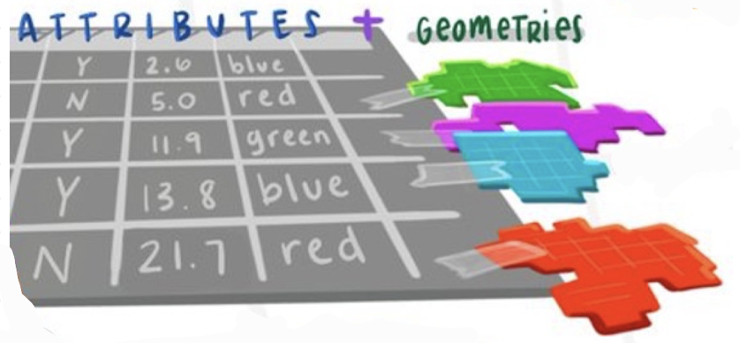
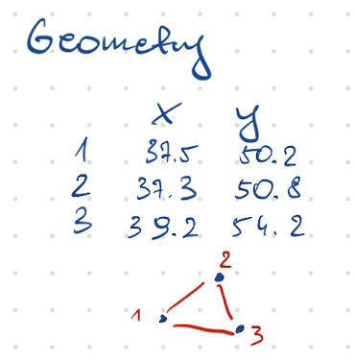
Simple features – description
Feature – items or objects that have spatial location or extent
  Building, road, administrative boarders of a country
Each feature has a geometry – definition of the spatial properties of a feature (point, point set, linestring, set of linestrings, polygon, set of polygons or a combination of these)
The simple aspect – all geometries are represented as a collection of points connected by straight line segments
Features can have attributes (color, name, measured quantity)

Slide 11


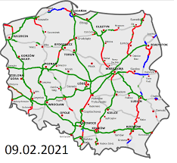
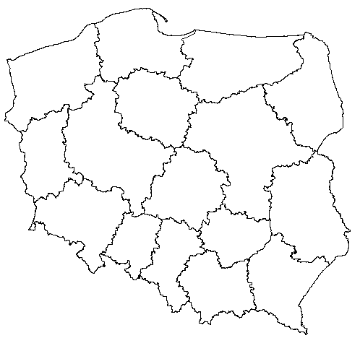
Examples of sf geometries
Point
Point set
Linestring
Set of linestrings
Polygon
Set of polygons
Building
Schools in Warsaw
Vistula river
Highways in Poland
Border of a country
Borders of voivodeships in Poland

Slide 12
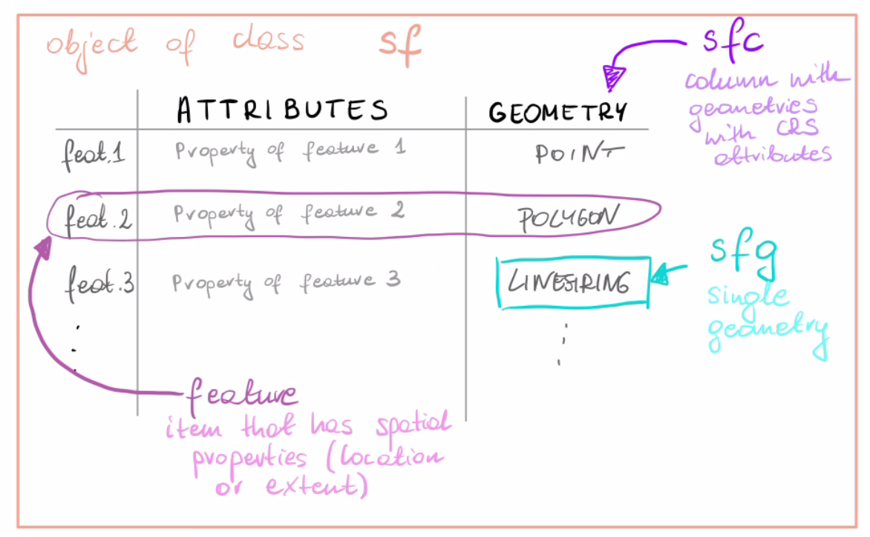

Slide 13
sp
S4 objects
Slot storage
Older and well developed
Compatible with statistical and
econometrical packages
sf
Data frames
Simple features
Dynamically developing
Compatible with tidyverse
and ggplot2
Compatible with statistical packages

Slide 14
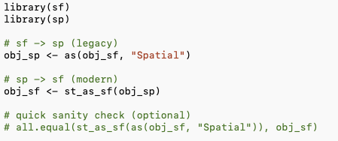
sf ↔ sp: conversion bridge (legacy compatibility)
Today we work in sf (tidy + modern ecosystem)
But you may still meet legacy workflows in sp
  older packages / older code / older papers
So the key practical skill is: convert, work, return
Use sf as default, convert to sp only when you must.

